Slide 2
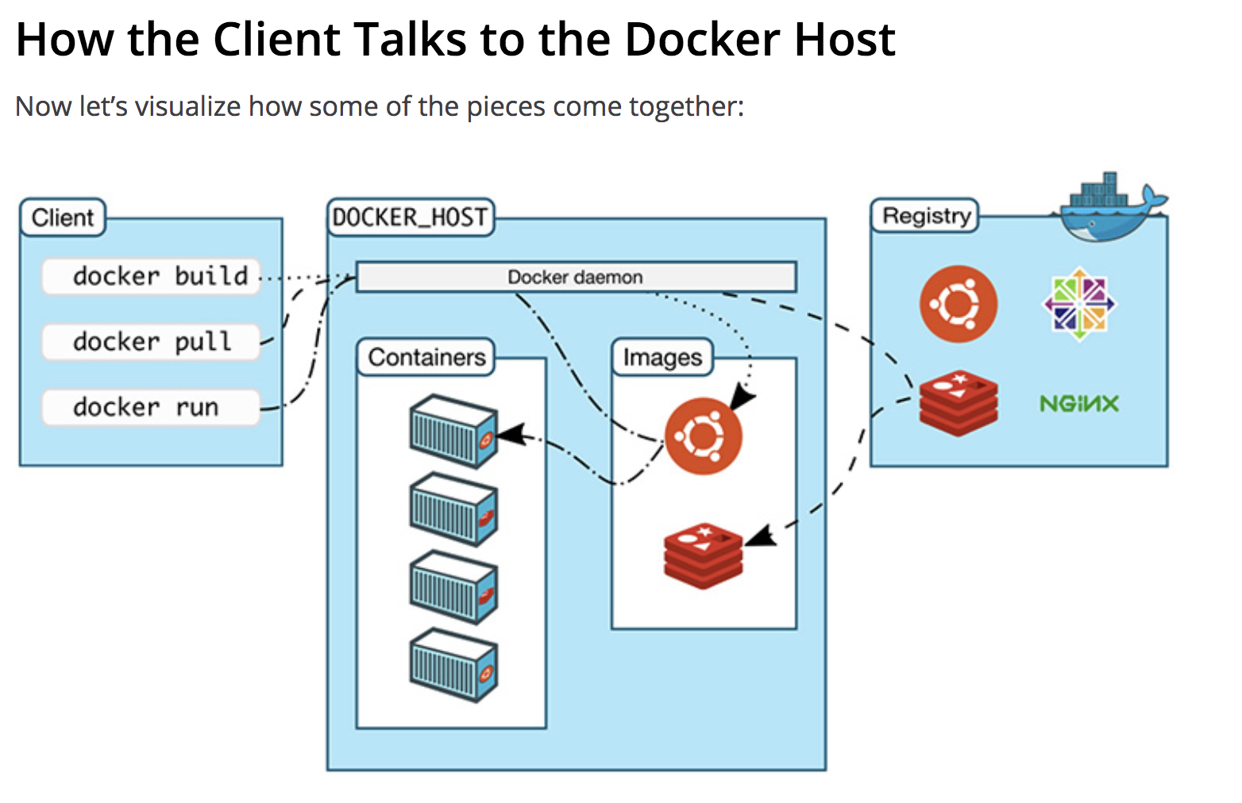

Slide 3
Docker Machines connect to DOCKER REGISTRY (Public/Private) (Hosted By Docker or 3rd Party)
D
O
C
K
E
R
V
O
L
U
M
E
E
X
T
E
R
N
A
L
D
O
C
K
E
R
V
O
L
U
M
E
I
N
T
E
R
N
A
L
CONTAINER (Instance of Image)
IMAGE(S)
STATIC
Read only
Code/Soft/
Platform Device Drivers
Create -> Destroy
Create -> Start -> Stopped -> Destroy
Create -> Start -> Pause -> Unpause
Create -> Start -> Restart
DOCKER NETWORK1
Bride Network, Overlay, Overlay2, MCLAN (CLOUD) overlay - ingress
Volume
From
AWS,
GCP etc (VOLUME=FLOCKER)
VOLUME = BIND VOLUME
DOCKER REPOSITORY (Inside Docker Machine)
DOCKER MACHINE1
DOCKER SWARM (Network of Docker Machines)

Slide 5
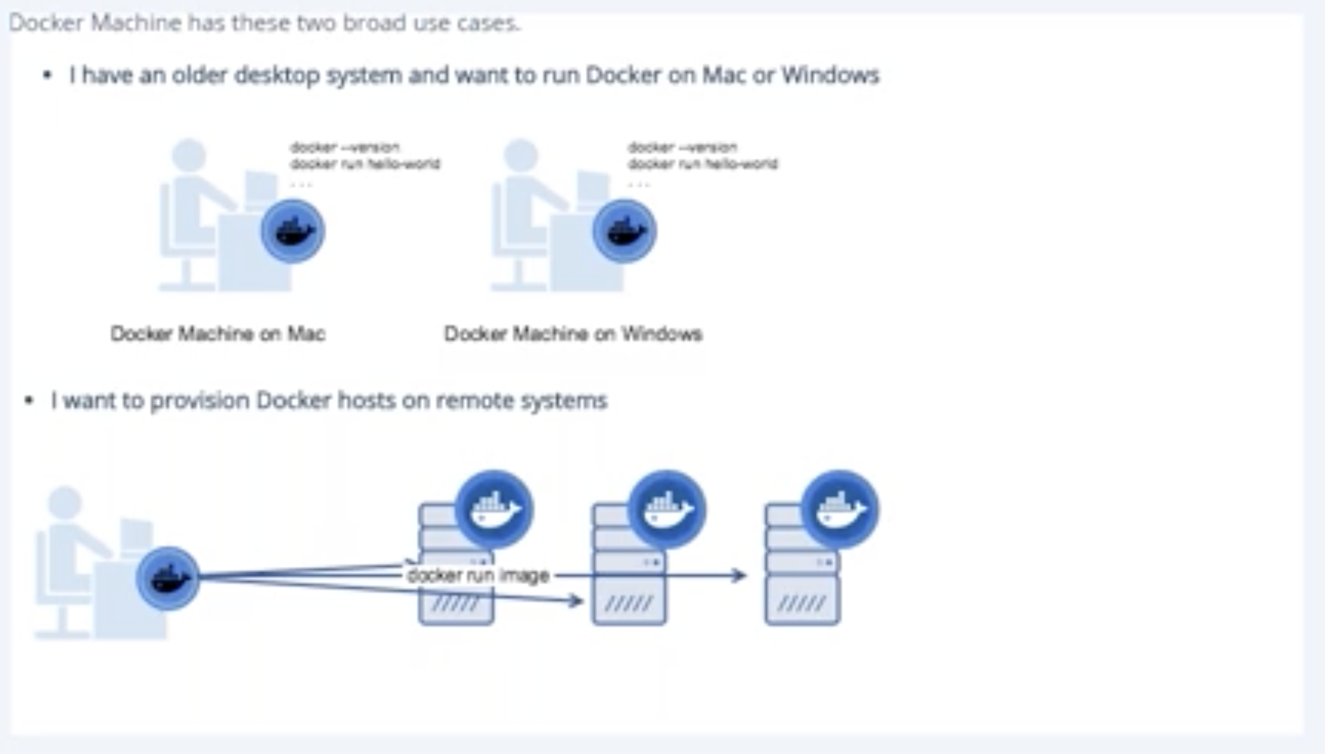

Slide 6
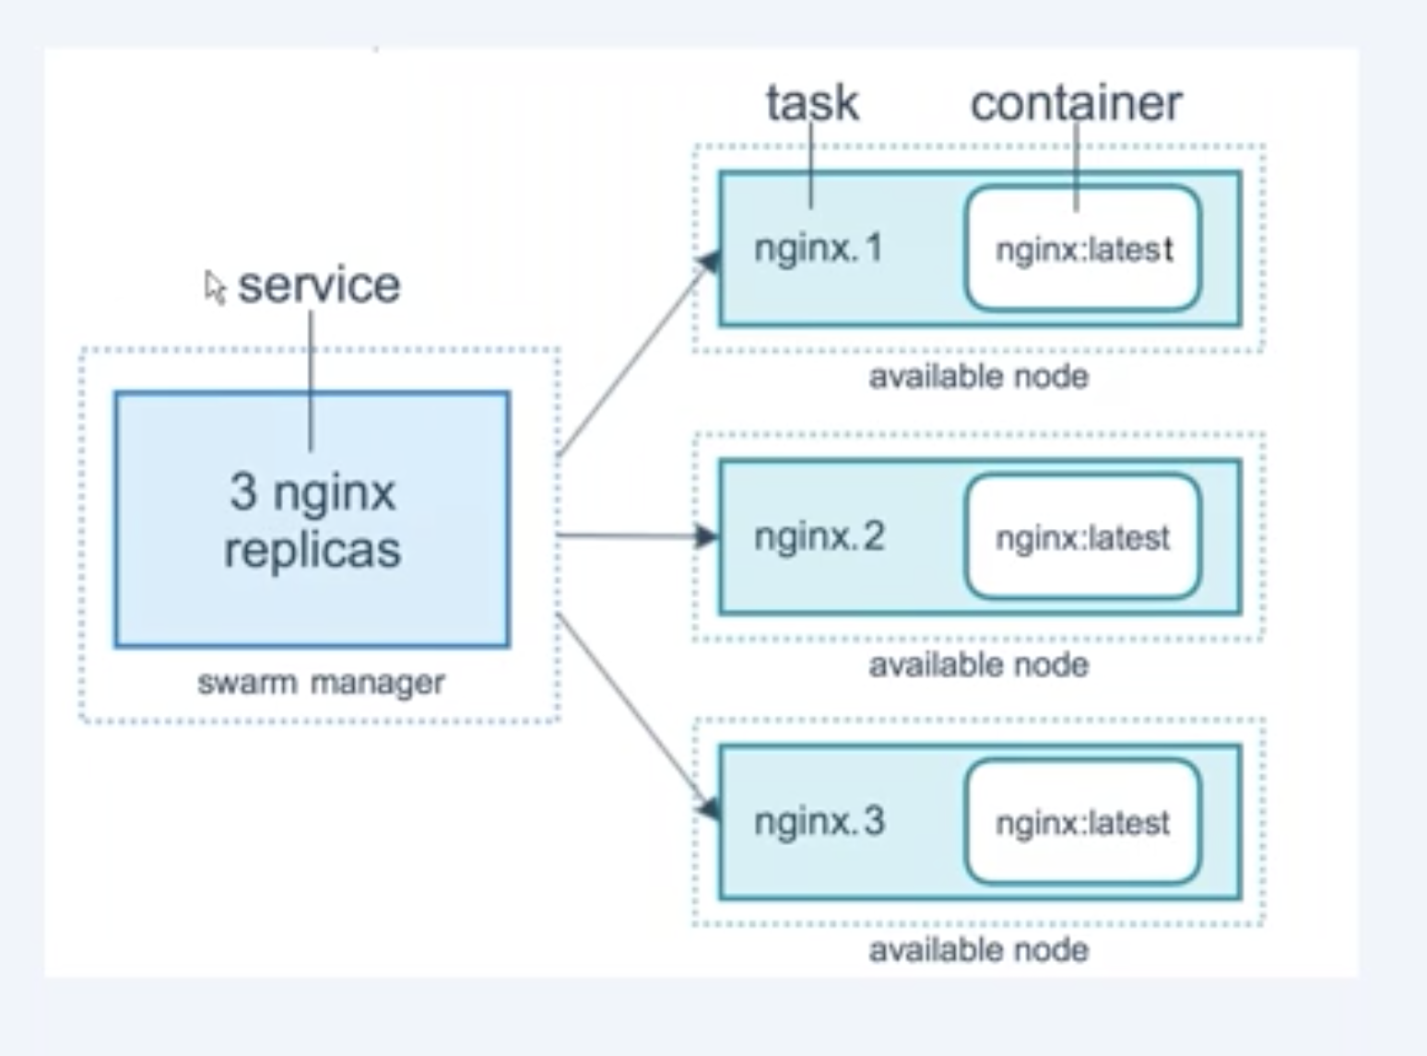
Service in Container World

Slide 7
LifeCycle of Image

Slide 8
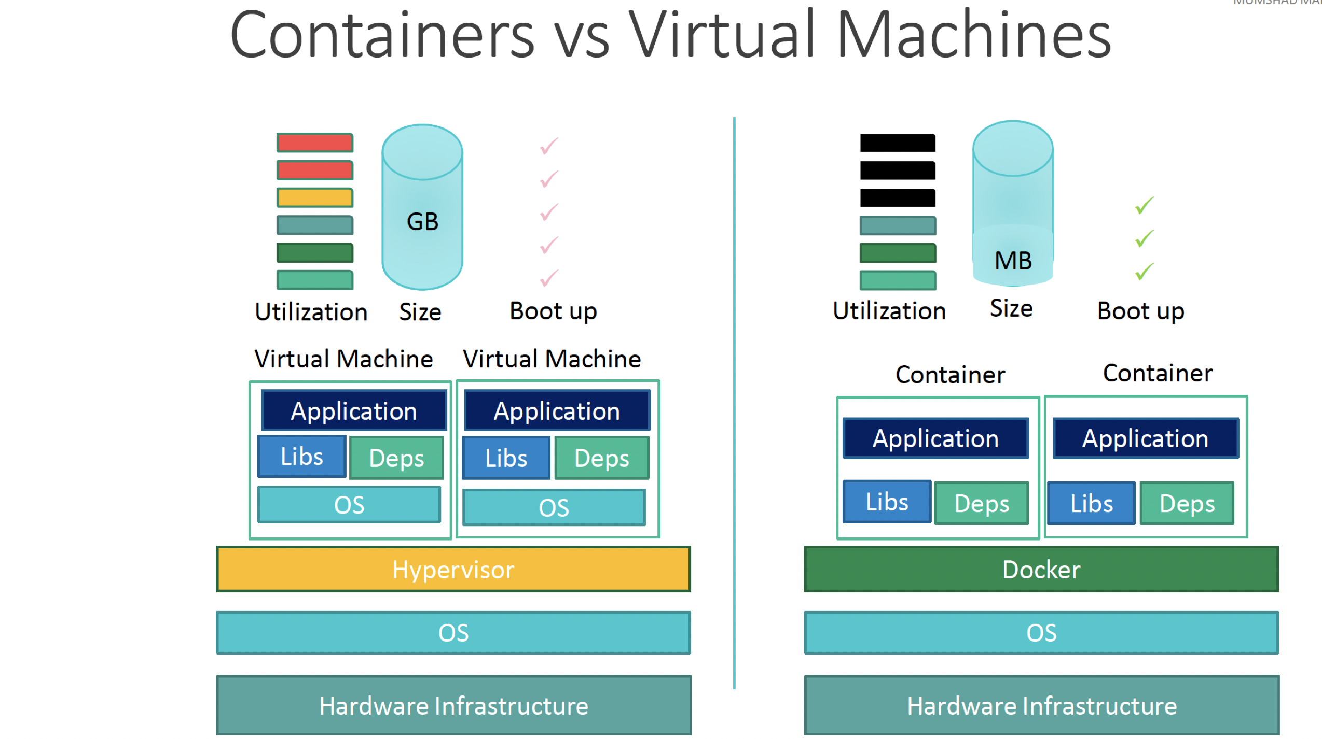

Slide 9
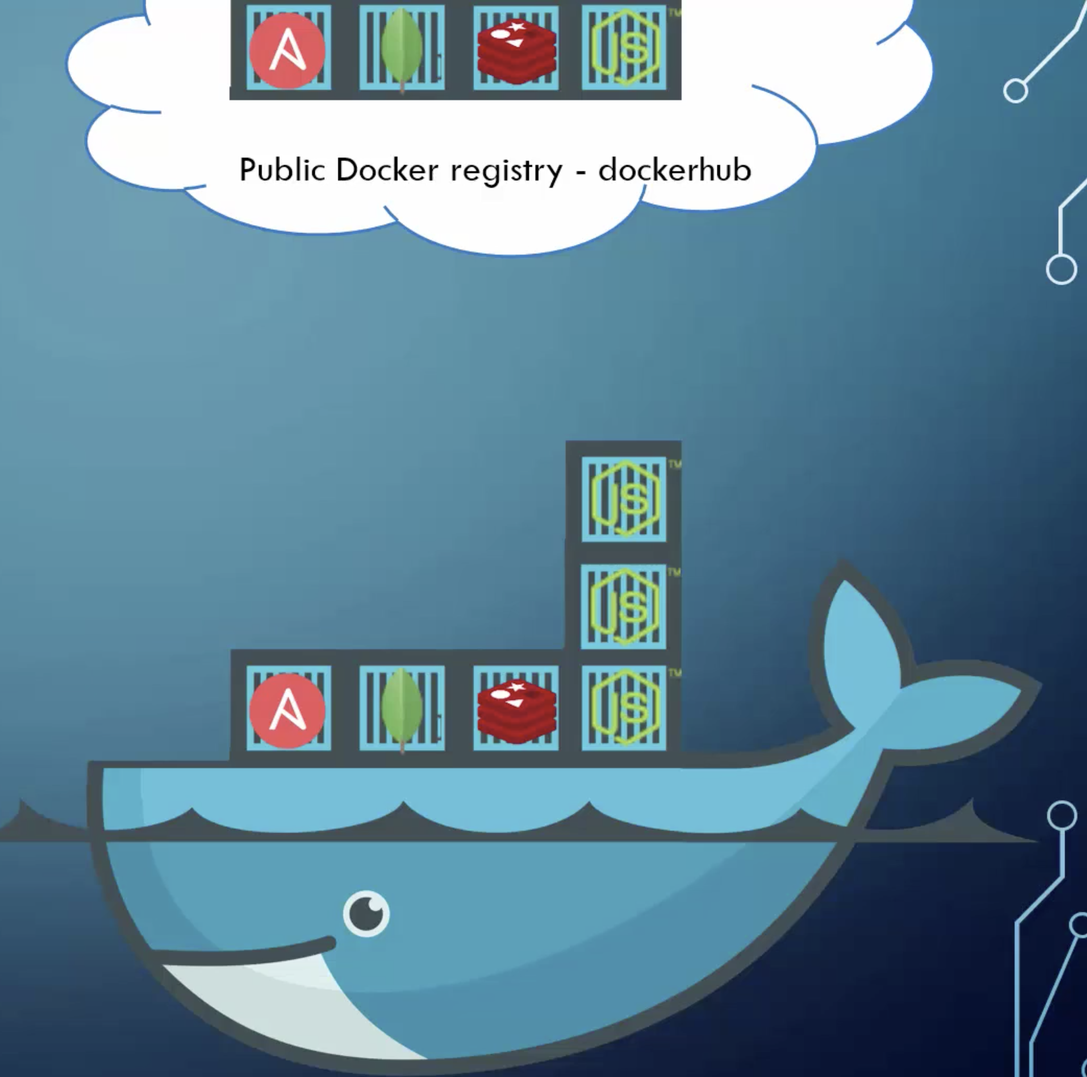
Docker Registry

Slide 10
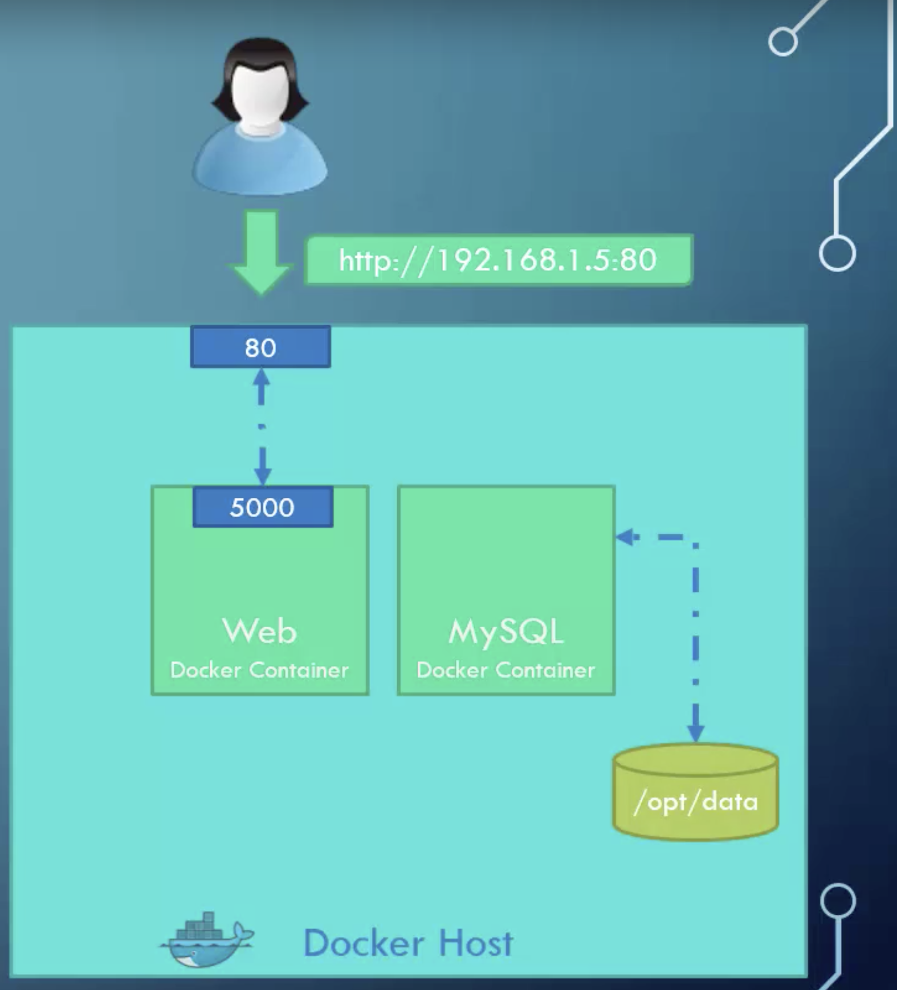
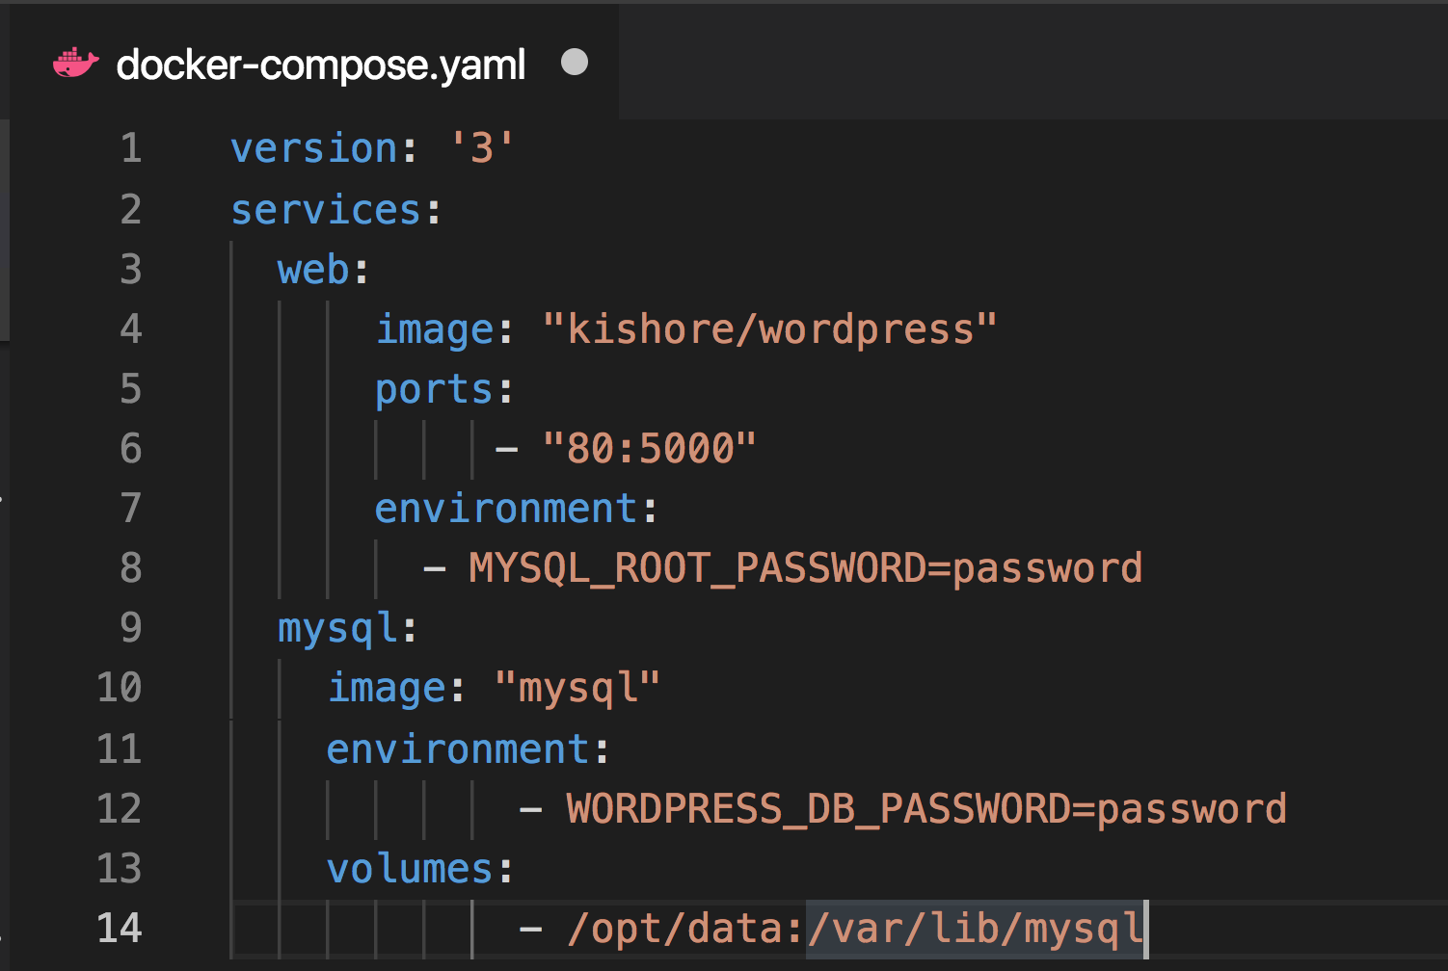
Docker-Compose
https://docs.docker.com/compose/compose-file/

Slide 11
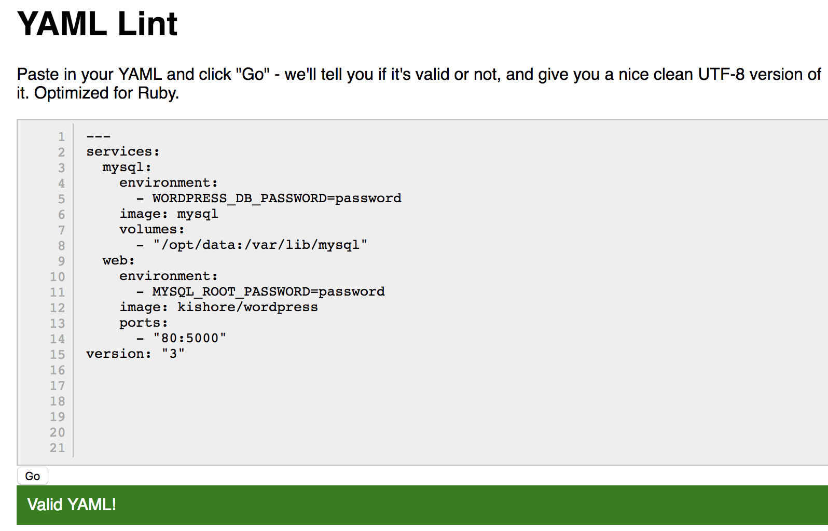
YAML VALIDATOR
http://www.yamllint.com/

Slide 12
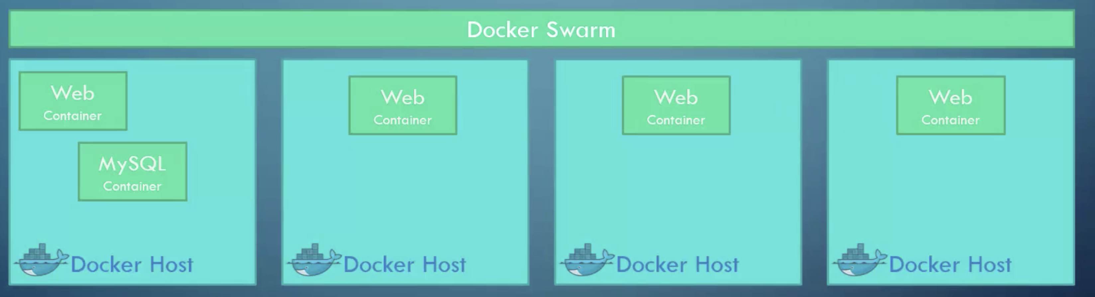
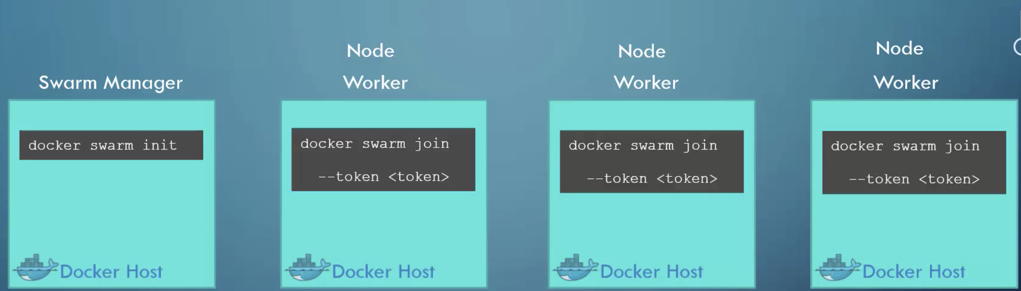
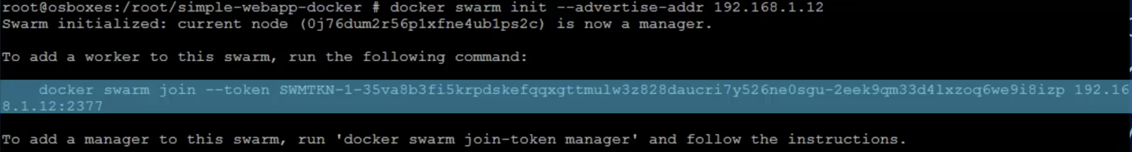
Docker Swarm

